Slide 1


Amazon Product Review Data Analysis
GROUP 2
Jaydeep J Chopde
Maitri S Shah
Monika Mishra
Pankti N Parikh
Rakshith Chandan Babu
Under the guidance of
Dr. Jongwook Woo

Slide 2

Introduction
With the quick growth of internet and it’s increasing accessibility, e-commerce has developed rapidly in the last few years.
With the introduction of e-commerce shops, we can buy anything with a click of the mouse.
The biggest disadvantage of e-commerce is that one is not able to see and feel the product.
Since consumers are not able to feel and touch the product, most of the the customers, on any online shopping sites, make purchasing decisions based on reviews and ratings.
And so it’s very important for business to know the various shopping patterns and customer’s sentiments based upon the reviews and ratings.

Slide 3

ABOUT THE DATASET
Dataset : - https://s3.amazonaws.com/amazon-reviews-pds/tsv/index.txt
Products reviewed between 2005 and 2015 are analyzed
Countries considered : US, UK, FR , DE
File Size : 5.26 GB
Number of Files : 7
File Format : TSV (Tab Separated Values),
CSV (Comma Separated Values)
Total no. of product reviews : 9.57 million

Slide 4

CLUSTER DETAILS
Cluster Version : Oracle Big Data Compute Edition
No. of Nodes : 5
Memory Size : 150 GB
CPU : 20 vCPU
HDFS Capacity : 147 GB
Storage : 678 GB

Slide 5

BIG DATA
Big data is a term used to refer to the study and applications of data sets that are too complex for traditional data-processing application software to adequately deal with.
It works on the principle that the more you know about anything the more reliably you can gain new insights and make predictions about it’s future. By comparing more data points, relationships begin to emerge and these relationships enable us to learn and make smarter decisions.

Slide 6

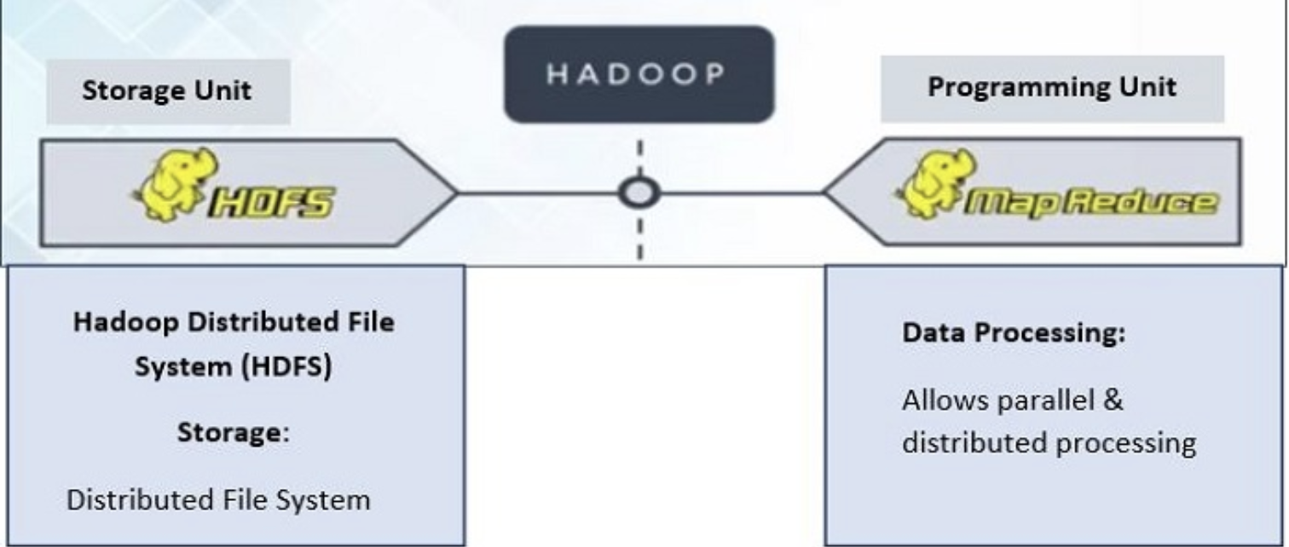
HADOOP
Hadoop is a framework to process Big Data. It is a framework that enables you to store and process large data sets in parallel and distributed fashion.
Hadoop Core Components:
Hadoop Distributed File System (HDFS) takes care of storage part of Hadoop architecture.
MapReduce is a processing model and software framework for writing applications which can run on Hadoop. These programs of MapReduce are capable of processing Big Data in parallel on large clusters of computational nodes.

Slide 7

HIVE
Hive is a data warehouse infrastructure tool to process structured data in Hadoop.
It resides on top of Hadoop to summarize Big Data, and makes querying and analyzing easy.
Initially Hive was developed by Facebook, later the Apache Software Foundation took it up and developed it further as an open source under the name Apache Hive.
It stores schema in a database and processed data into HDFS.
It provides SQL type language for querying called HiveQL.
It is familiar, fast, scalable, and extensible.

Slide 8






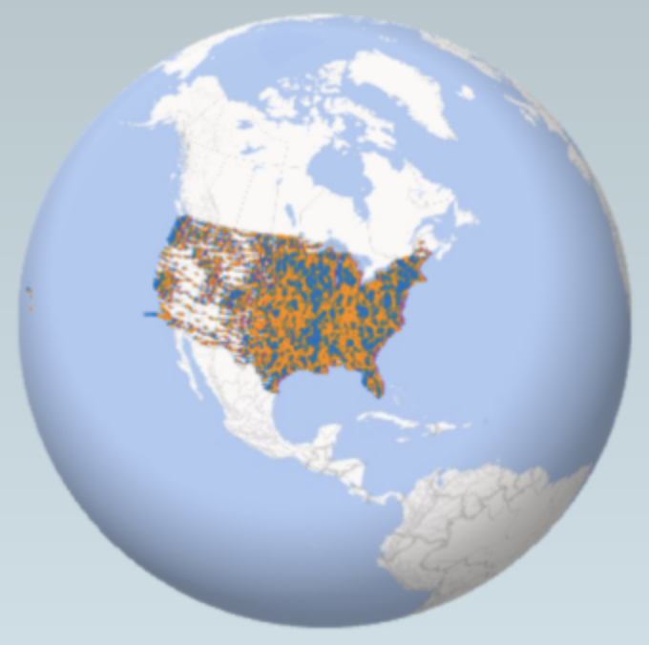

FLOWCHART
Download Dataset
Upload data into HDFS
Trigger Hive Queries
Output Visualizations
Find Insights

Slide 9

VISUALIZATIONS

Slide 10
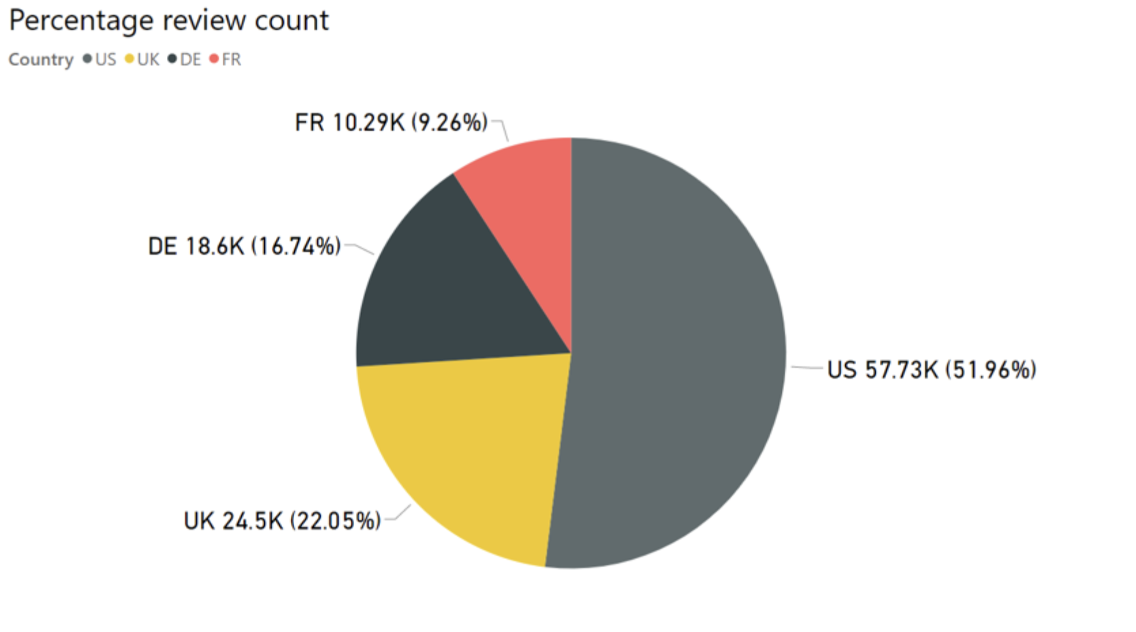
Total review count by country

Slide 11
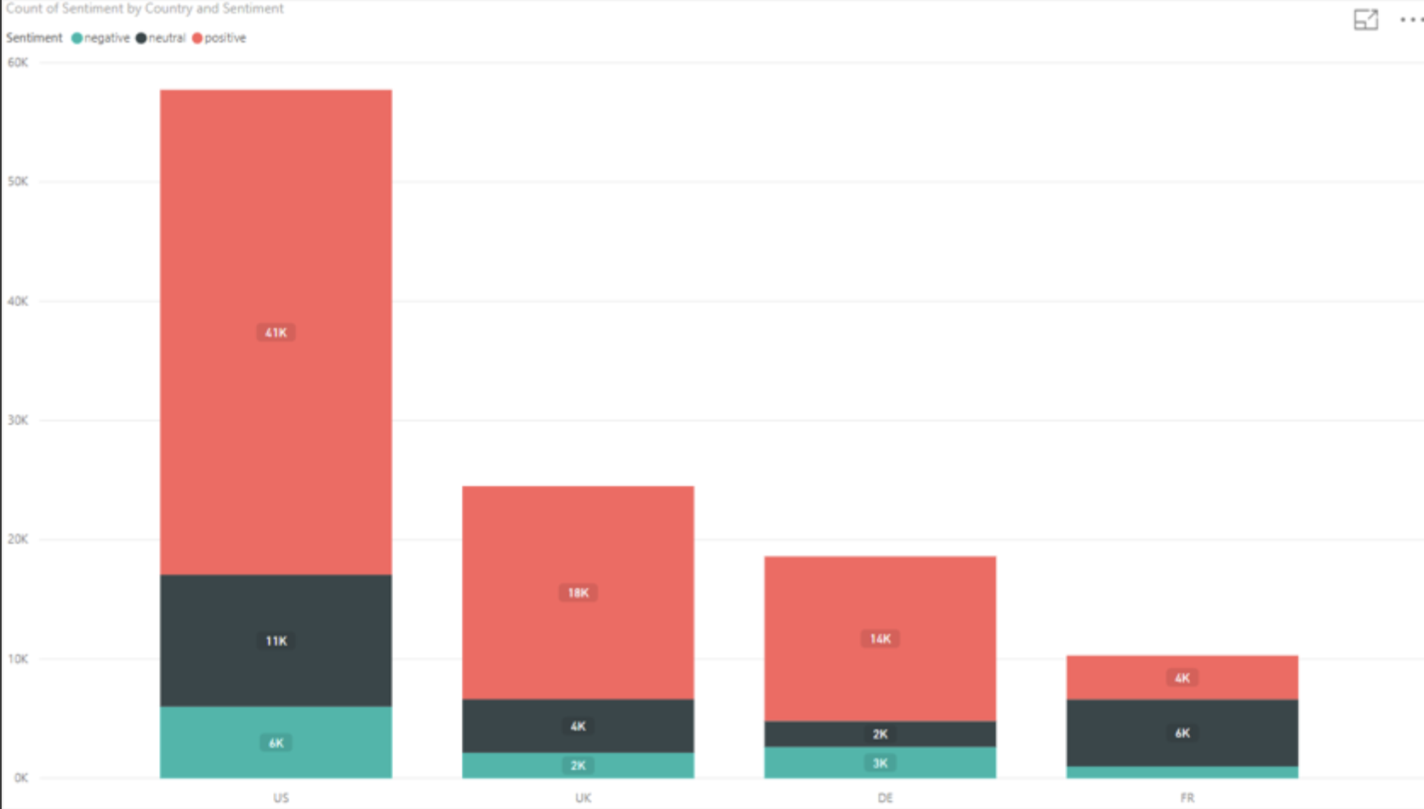
Count of reviews by country

Slide 12
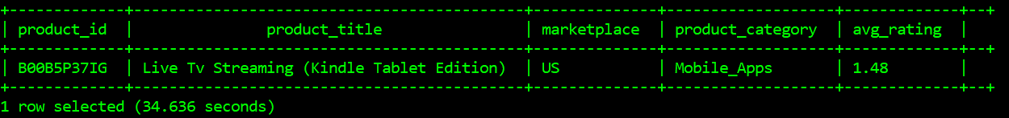
Least Rated Product
Only Product with at least 50 review were considered
The least rated product is at 1.48

Slide 13
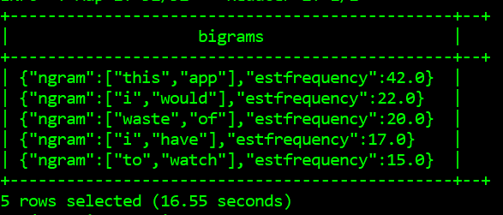
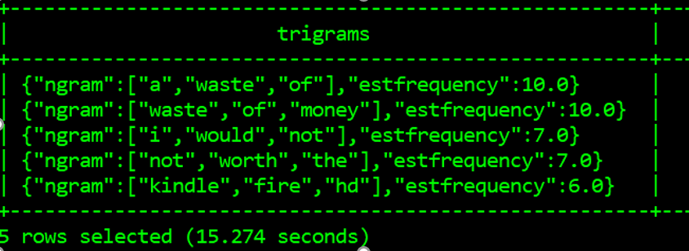
Common Words used in comments
Bigrams
Trigram
The most common phrase is “waste of”.

Slide 14
Inights of the Sentiment Analysis
Problems
Misleading Description
No free choice for streaming.
No Support for local channels
Solution
Proper discription.
Addition streaming service.
Support for local channels.

Slide 15
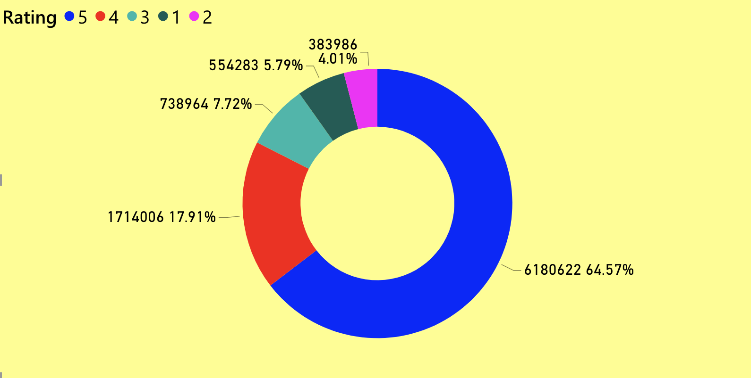
Distribution of overall ratings of amazon products

Slide 16
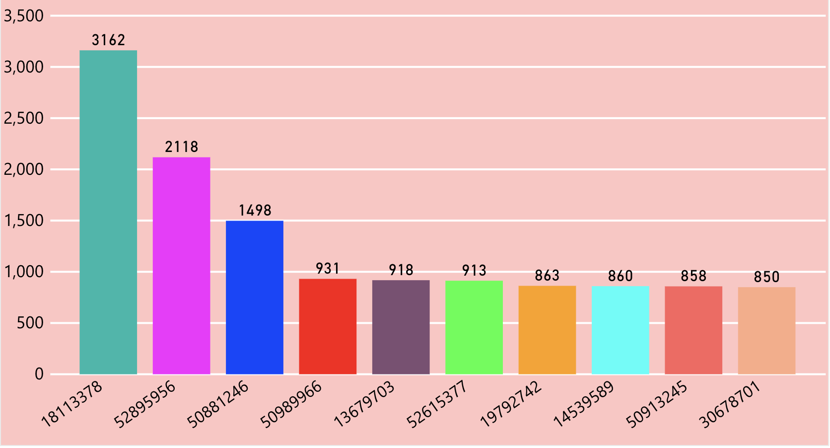
Number of reviews given by unique users over 10 years

Slide 17
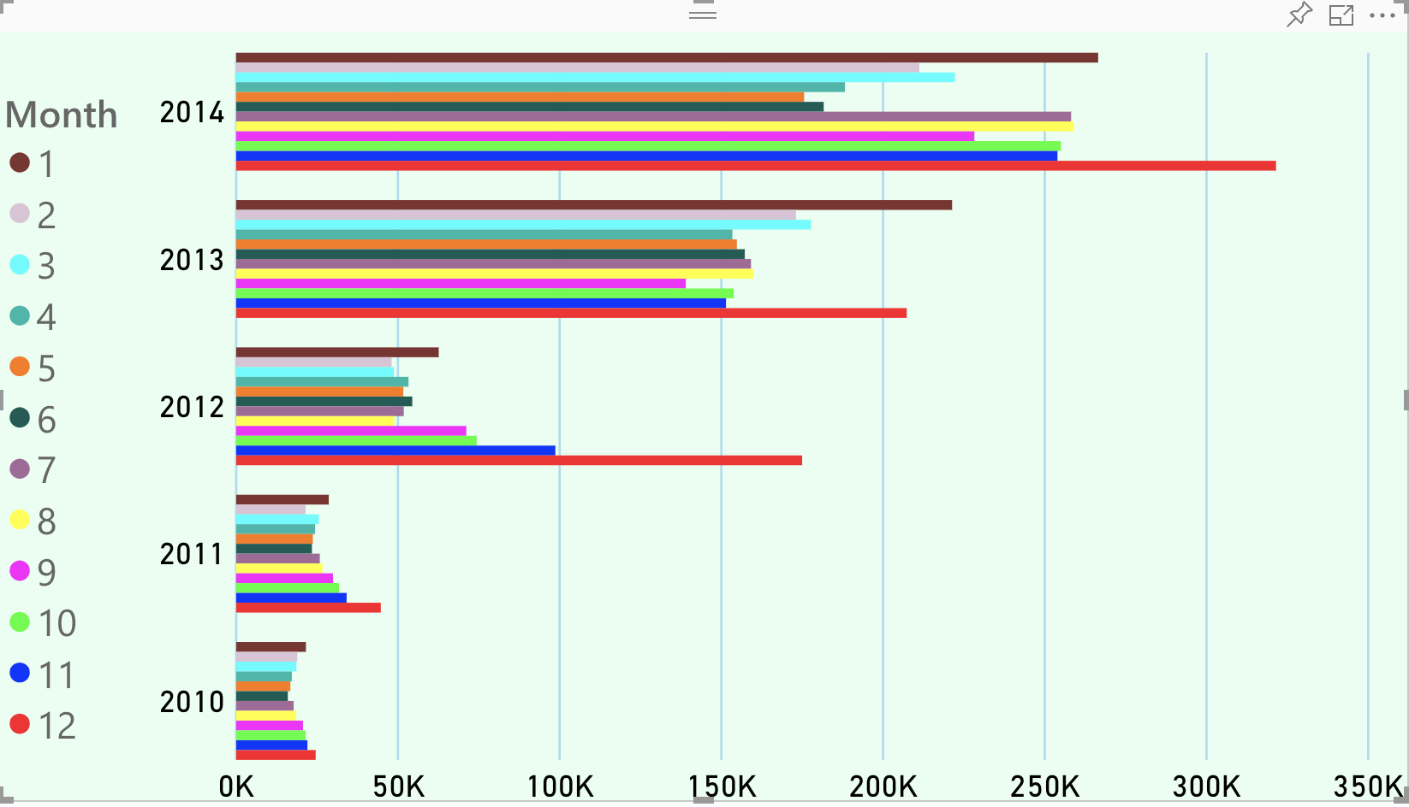
Review count by year and month

Slide 18
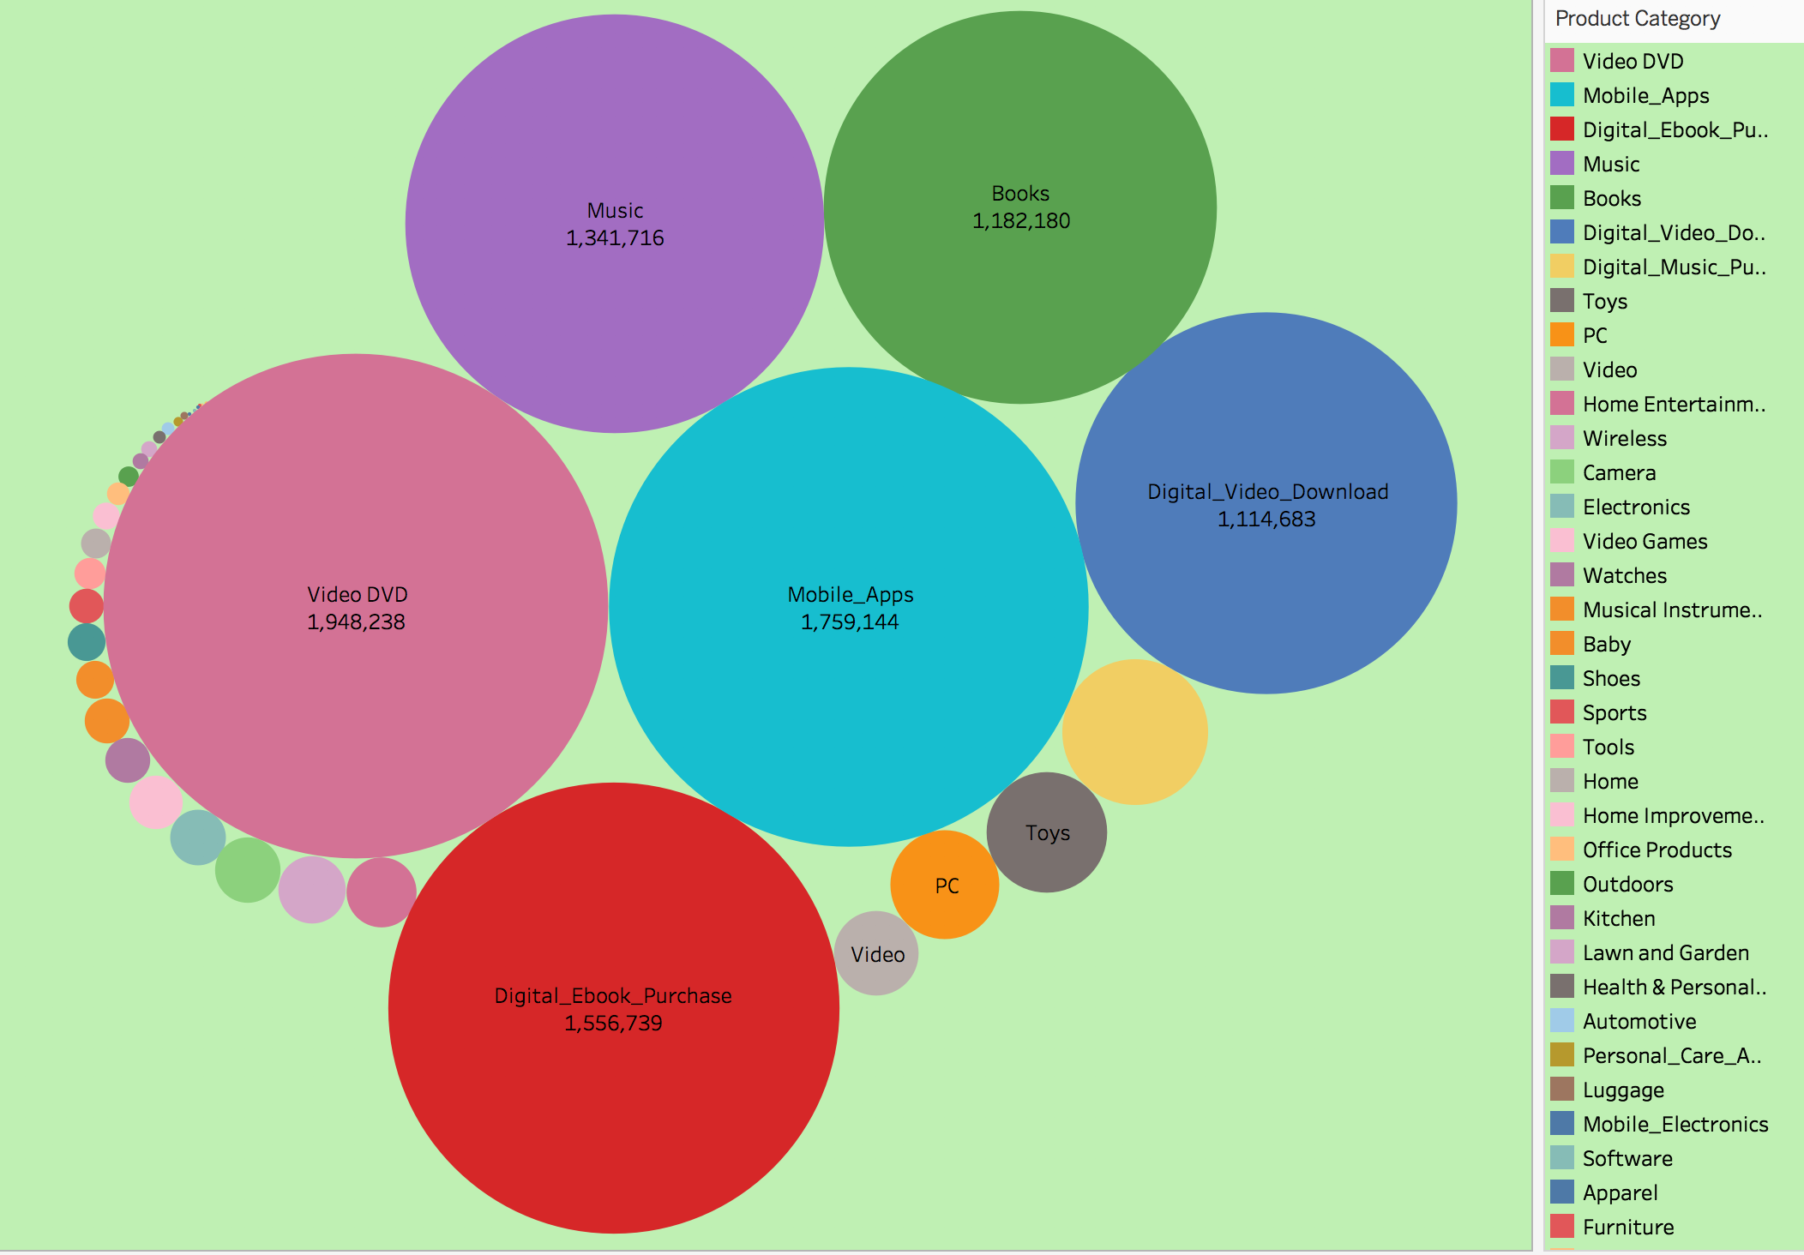
Review count for product category

Slide 19
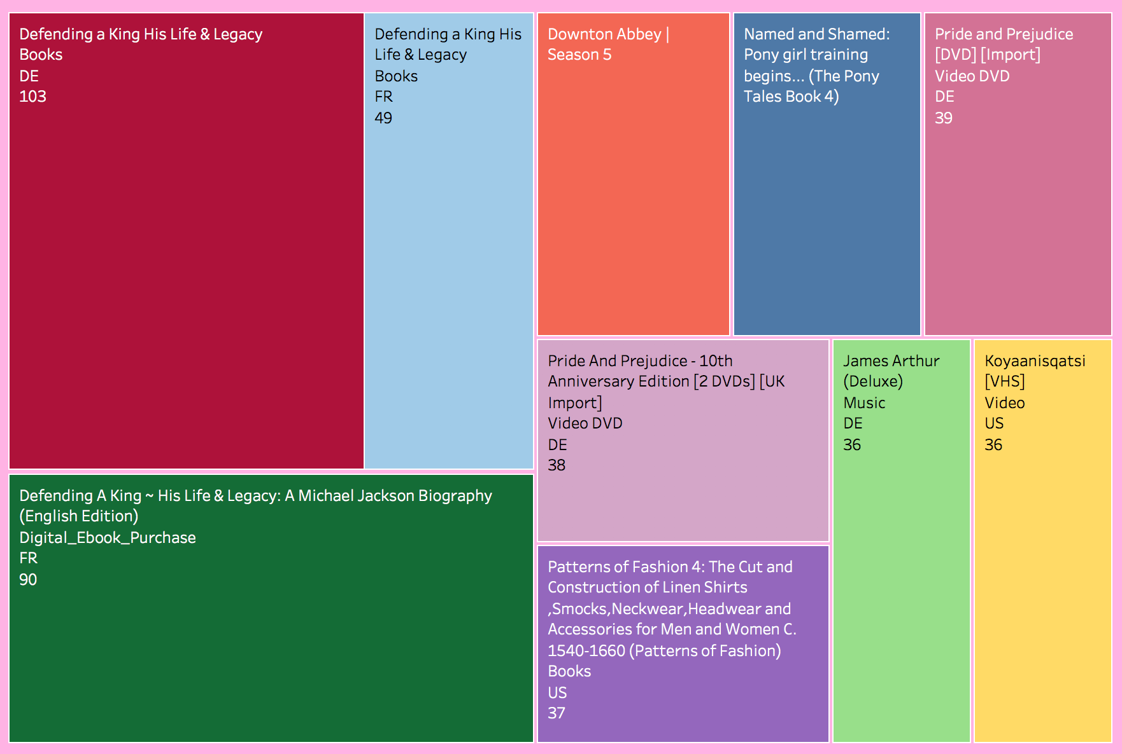
Popular product based on average rating and review count

Slide 20
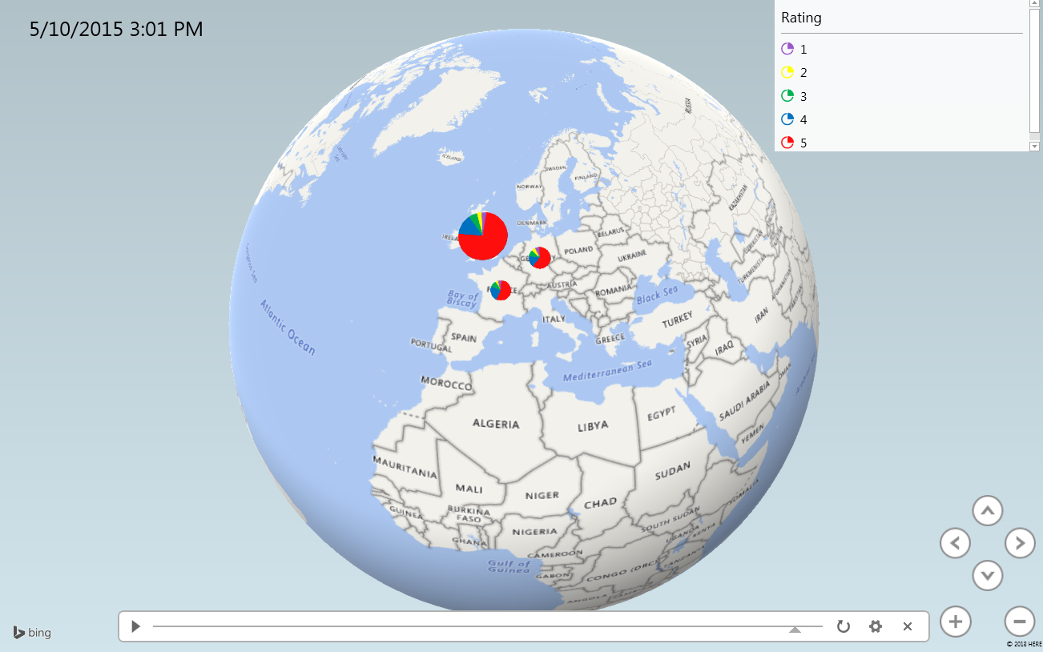
Rating based geospatial representation for product category-baby

Slide 21

INSIGHTS
Books is the most popular category based on ratings and reviews.
Around 3,162 reviews(maximum) were written by one user in the span of 10 years.
The review count has gradually increased over the years.
The review count is maximum in the holiday months – November, December, January.
64.57% people gave the maximum rating 5 to the products.
Video DVD received the maximum number of reviews.
The consumer sentiments is mostly positive in US, UK and Germany country.
Digital products have received more reviews than the non-digital products.

Slide 22

GITHUB LINK
https://github.com/monika2403/mmishra2

Slide 23
Data Source URLs
US : https://s3.amazonaws.com/amazon-reviews-pds/tsv/amazon_reviews_multilingual_US_v1_00.tsv.gz
DE : https://s3.amazonaws.com/amazon-reviews-pds/tsv/amazon_reviews_multilingual_DE_v1_00.tsv.gz
UK : https://s3.amazonaws.com/amazon-reviews-pds/tsv/amazon_reviews_multilingual_UK_v1_00.tsv.gz
FR : https://s3.amazonaws.com/amazon-reviews-pds/tsv/amazon_reviews_multilingual_FR_v1_00.tsv.gz
US Dictionary : https://s3.amazonaws.com/hipicdatasets/dictionary.tsv
German Dictionary : http://www.ulliwaltinger.de/sentiment/GermanPolarityClues-2012.zip
French Dictionary : http://www.ulliwaltinger.de/sentiment/GermanPolarityClues-2012.zip

Slide 24
REFERENCES
https://aesthetecurator.com
https://en.wikipedia.org/wiki/Big_data
https://www.bernardmarr.com/
https://github.com/
https://s3.amazonaws.com/
http://www.ulliwaltinger.de/sentiment/
https://www.dropbox.com/home/cis4560_5200Fall2018/termProjectsGuidelines

Slide 25


